Slide 1
MYEnterprise
Kelompok 5
Achmad Zaidan Lazuardy
Ivander Andreas wijaya

Slide 2

MYEnterprise : About
MYEnterprise is a Enterprise Resource Planning app that help organization manage their resource and daily operation. There are 4 features provided by this app:
Project Management,
CRM (Customer Relationship Management),
HRMS (Human Resource Management System), and
IMS (Inventory Management System)

Slide 3
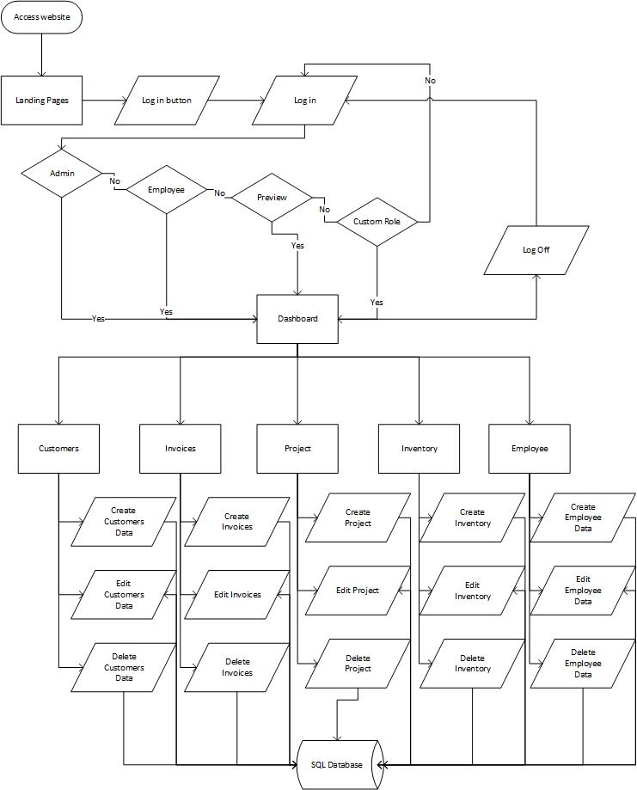
FLowchart

Slide 4
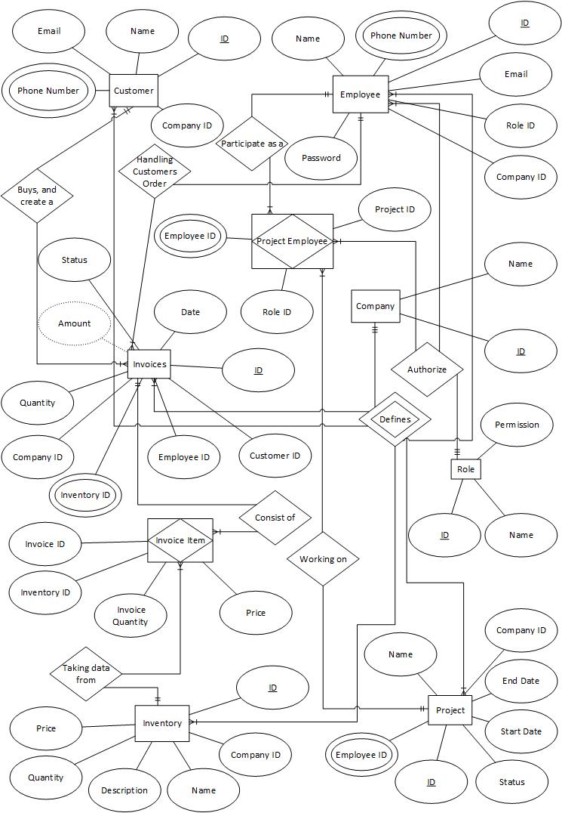
Entity relationship diagram

Slide 5
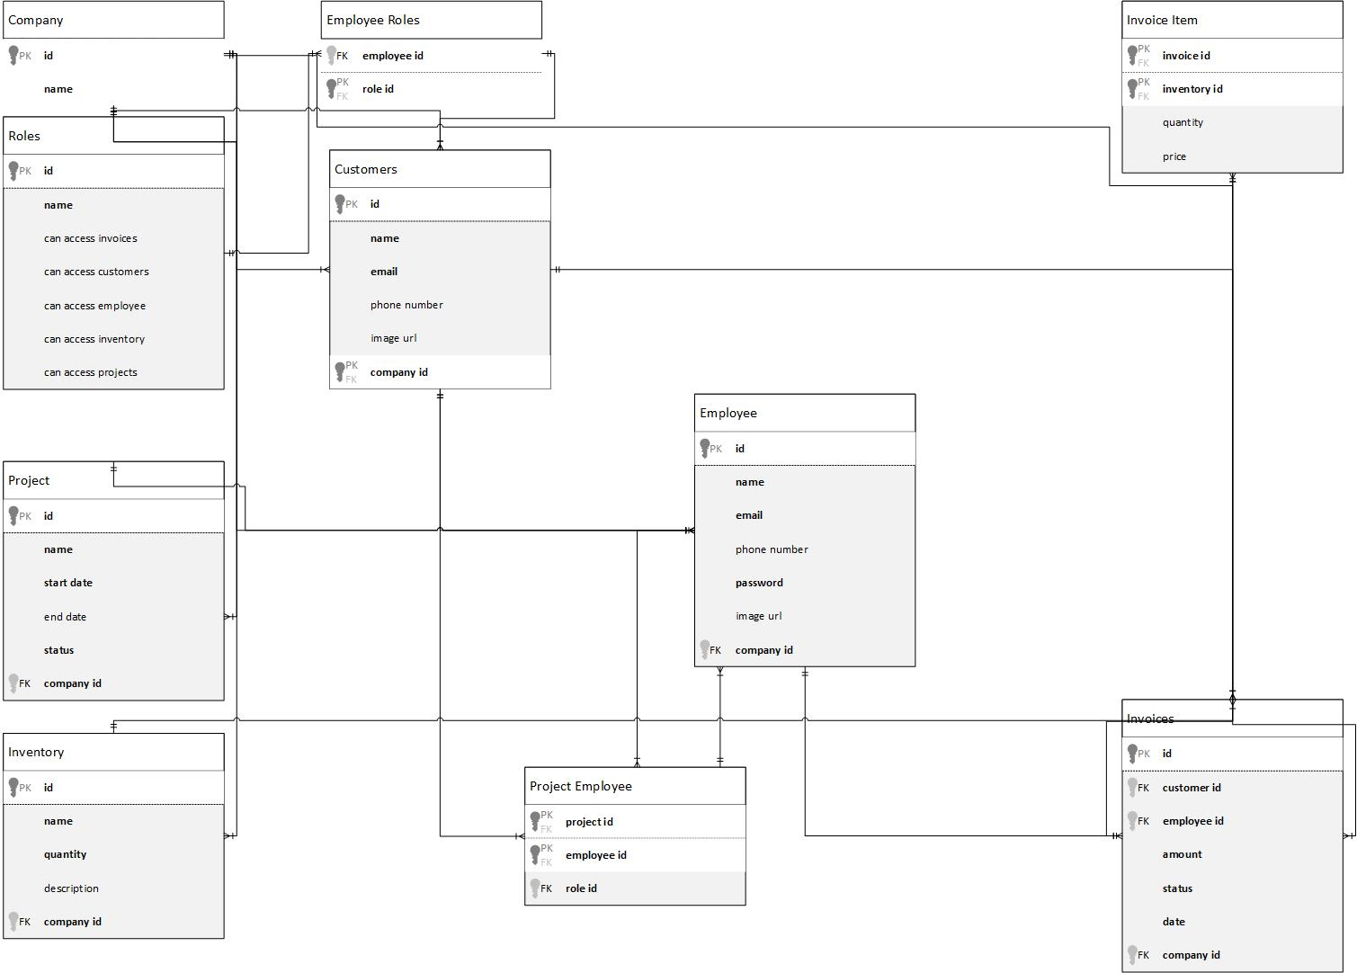
uml

Slide 6
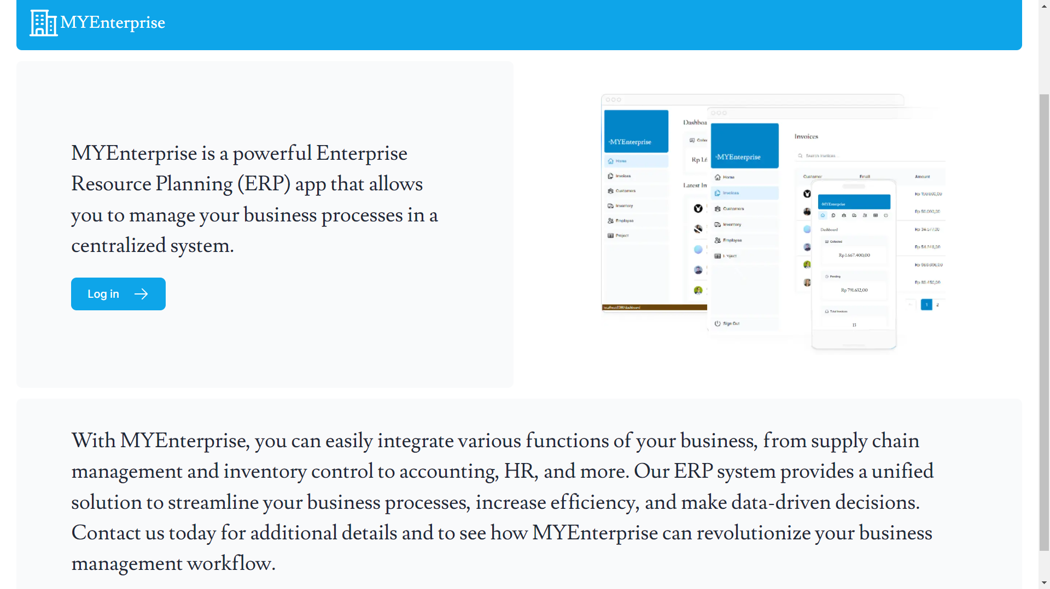
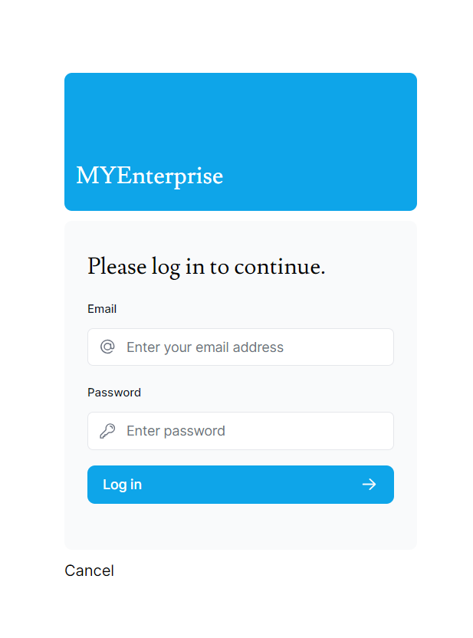
login

Slide 7
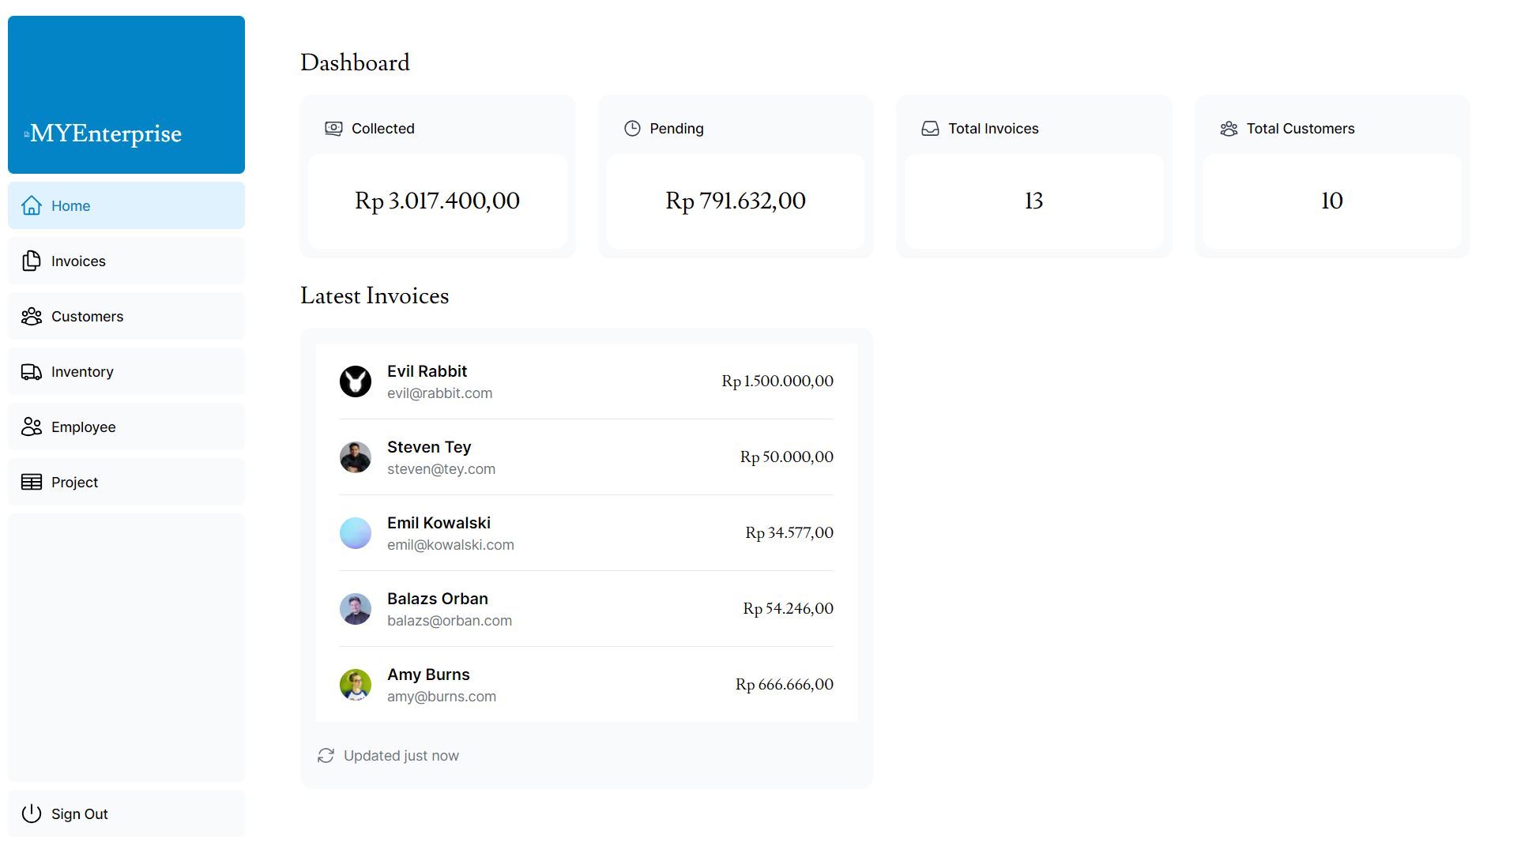
dashboard

Slide 8
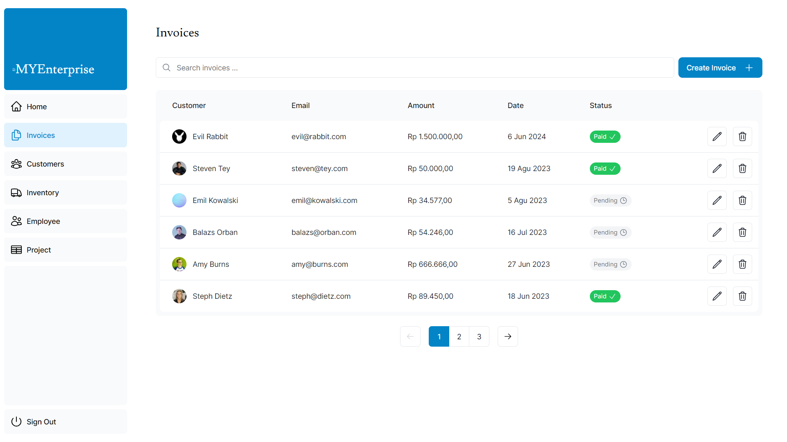
invoces

Slide 9
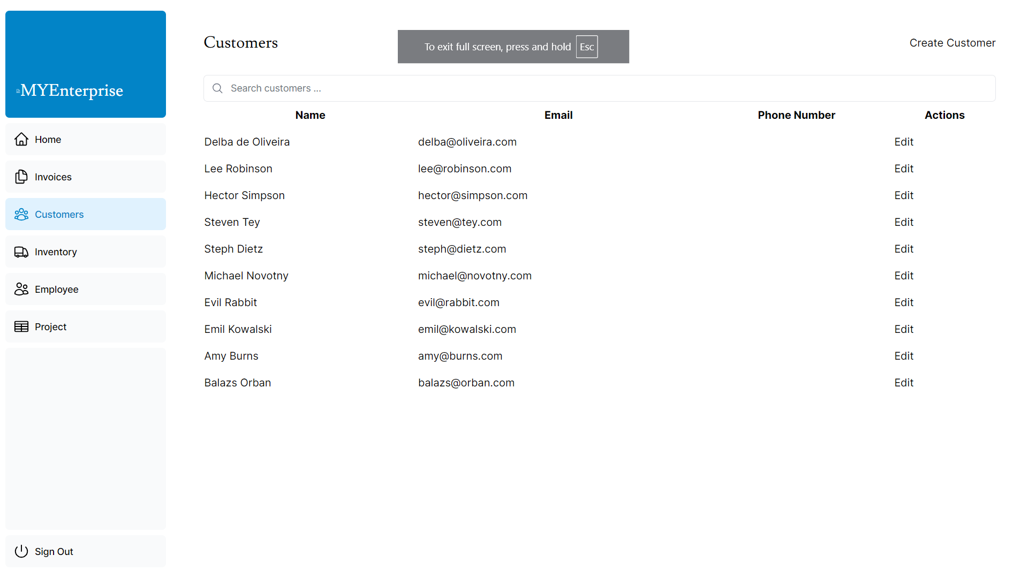
customers

